Slide 1

Bio 16 Difuse
Pierre Desvallons and quang nguyeng

Slide 2
Introduction
In this lab students will determine whether an environment is a carbon dioxide source or sink.
Students will explore and analyze data in order to predict what affects the Net Ecosystem Exchange of carbon dioxide.

Slide 3


UI interface
Eddy Covariance lab divided in two Big sections Raw Data Exploration and processed Data Exploration.

Slide 4
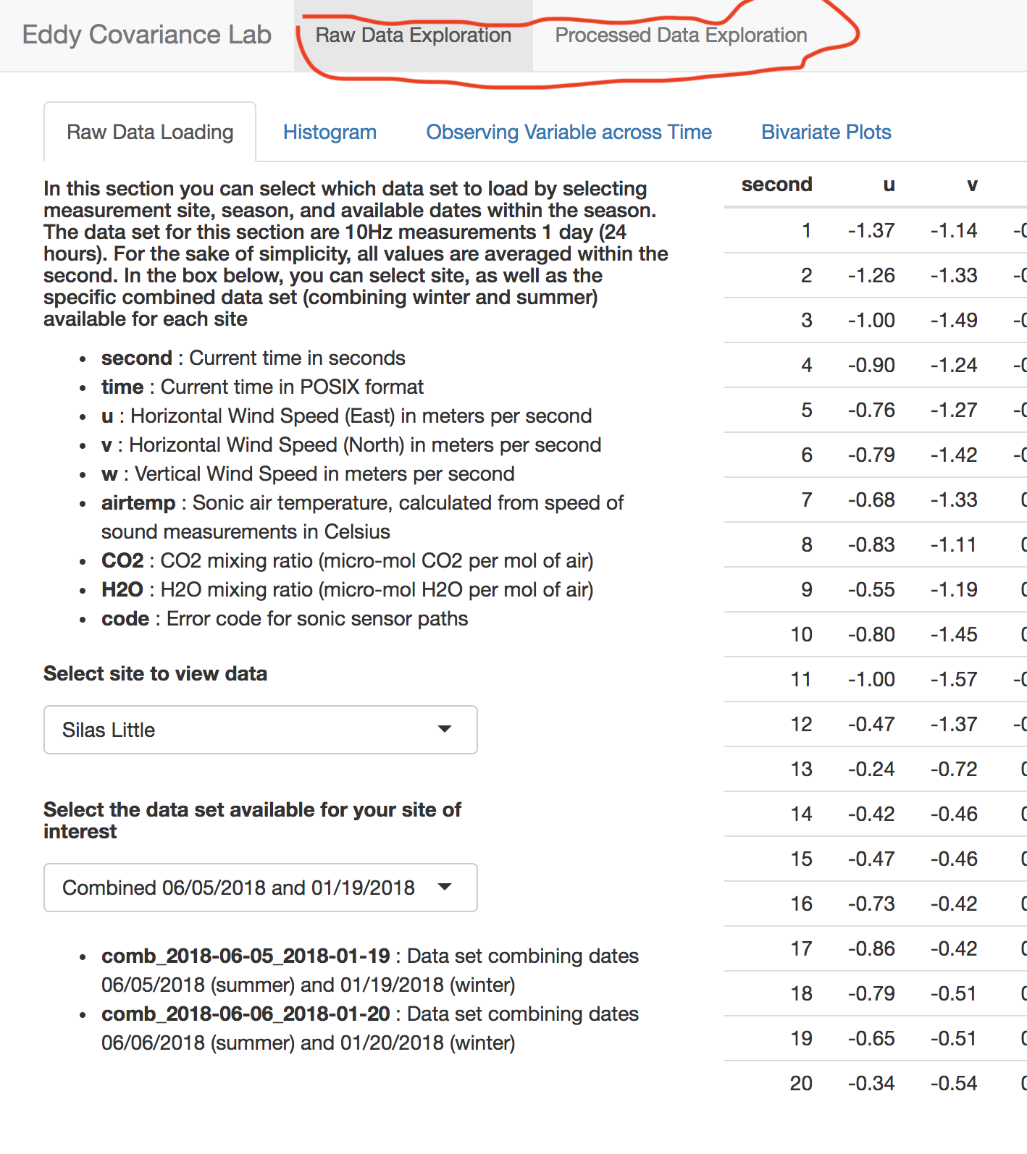

Slide 5

Raw Data Exploration
The students will be given the opportunity to work with data taken from real sensors.
There are three types of graphs have already been chosen to help the students to analyze the raw data and make predictions

Slide 6
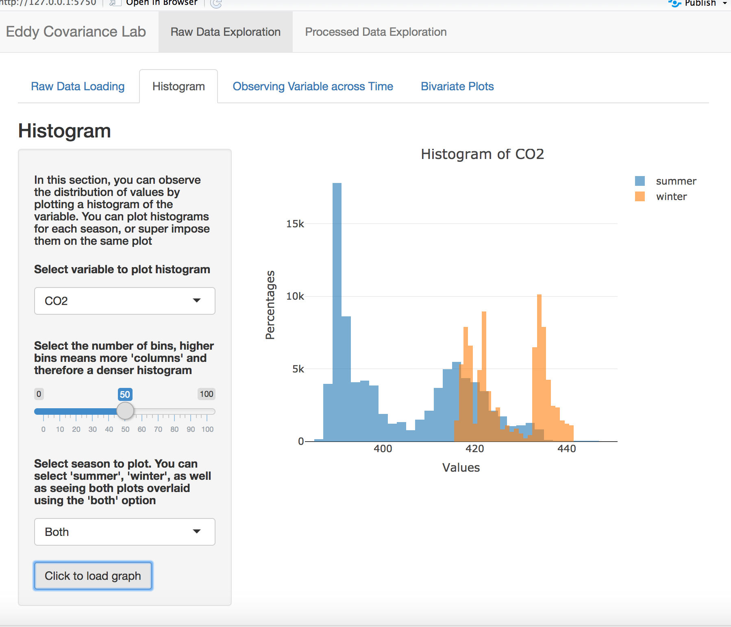
Histogram
The students are given variable options to graphs
Students can overlay winter and summer on both graphs

Slide 7
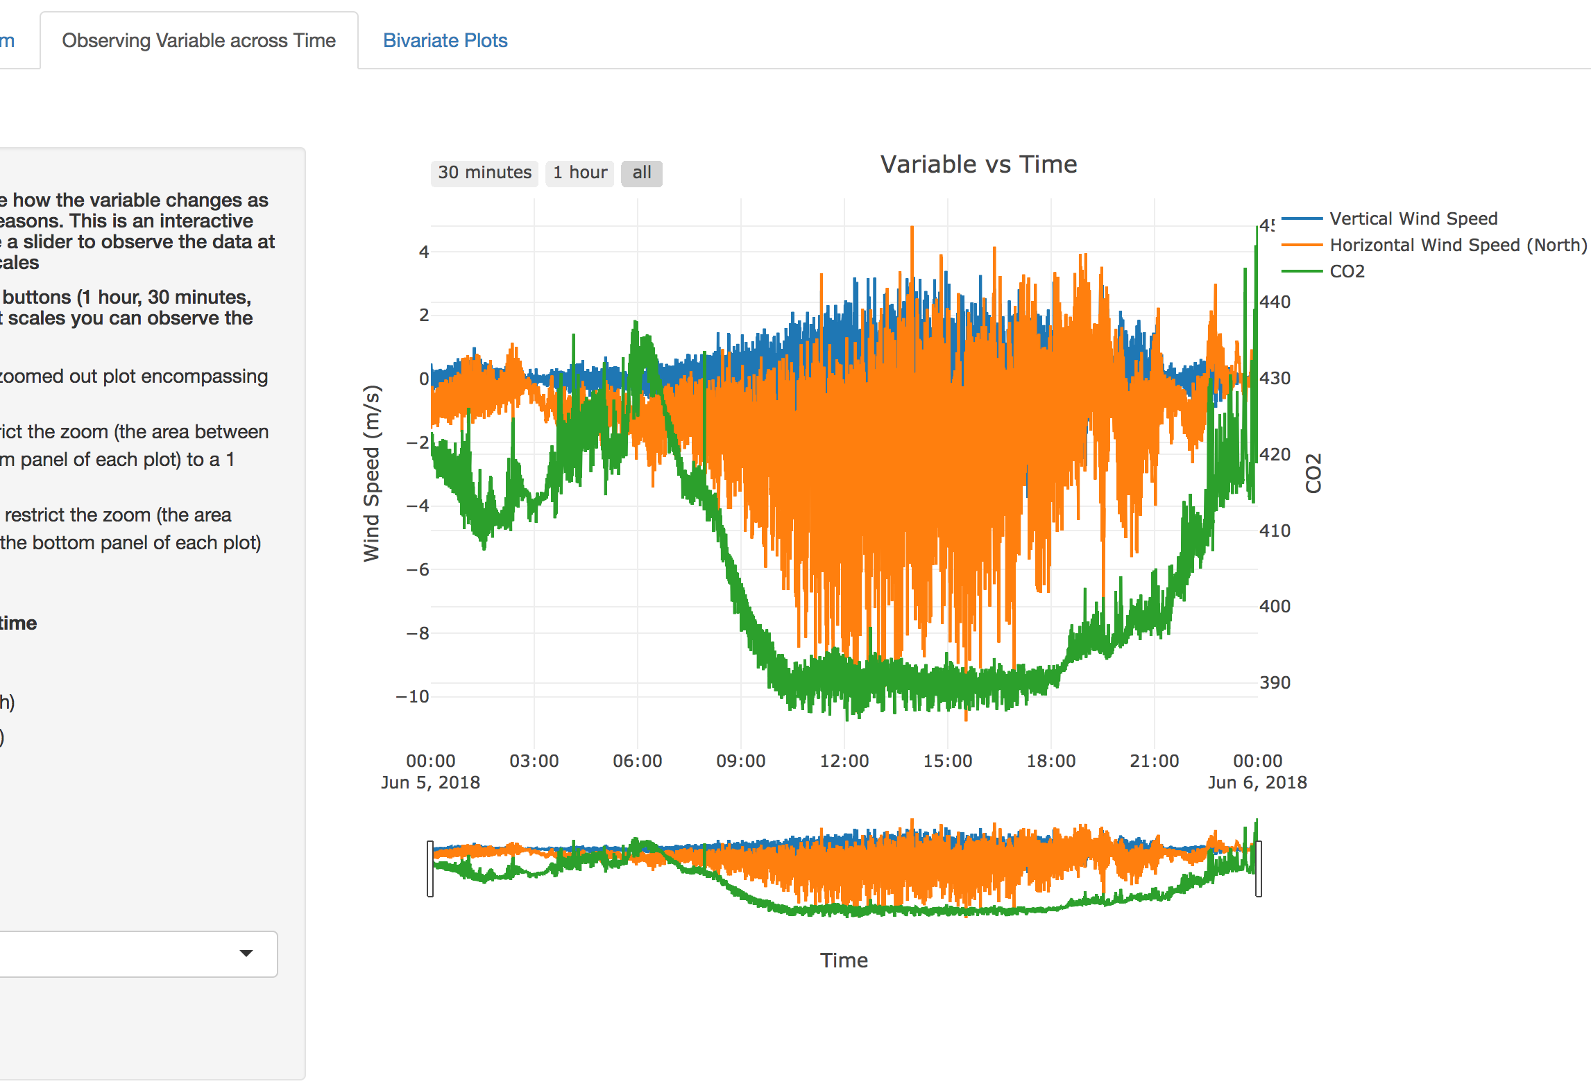
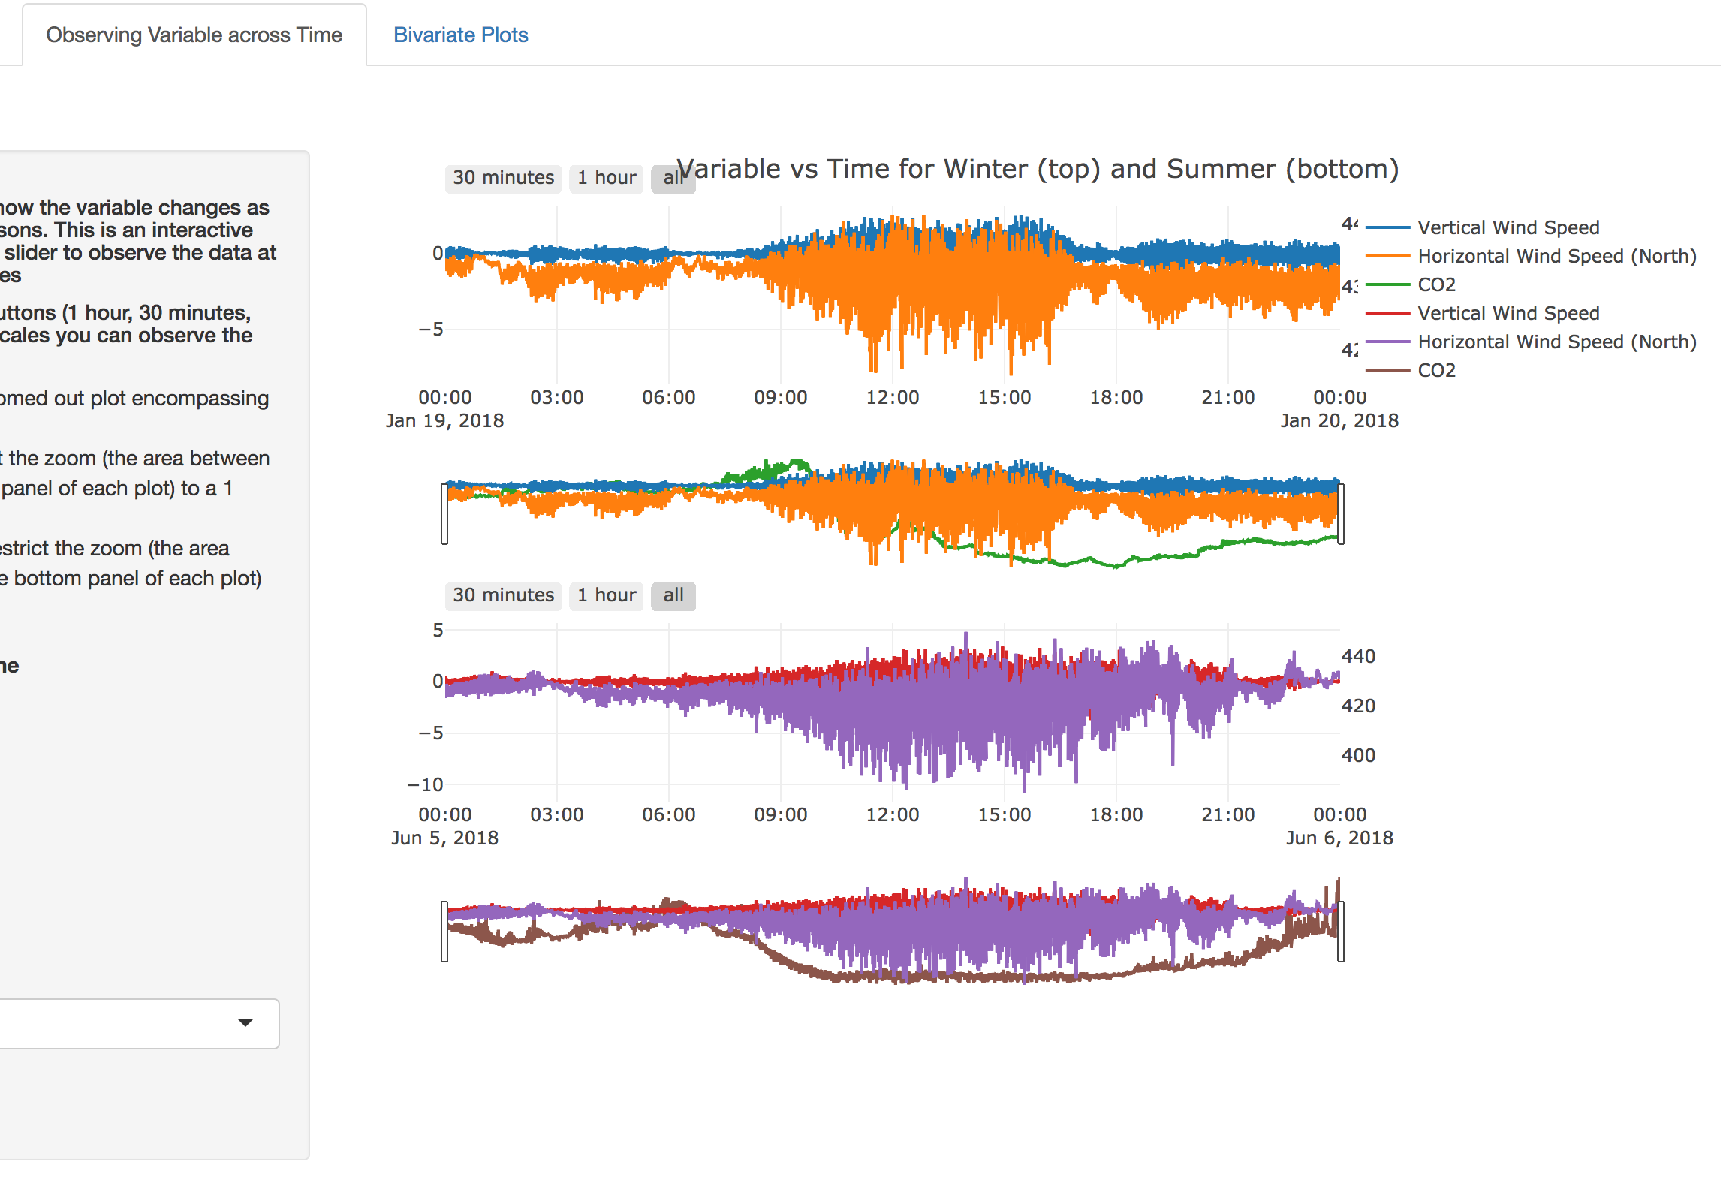
OBserving Variable Vs Time
This graph is intended for the students to make conclusions on the interaction of wind variables and other variables with respect to time
Students can zoom in by using the range selector feature.
Students can also see both winter and summer

Slide 8
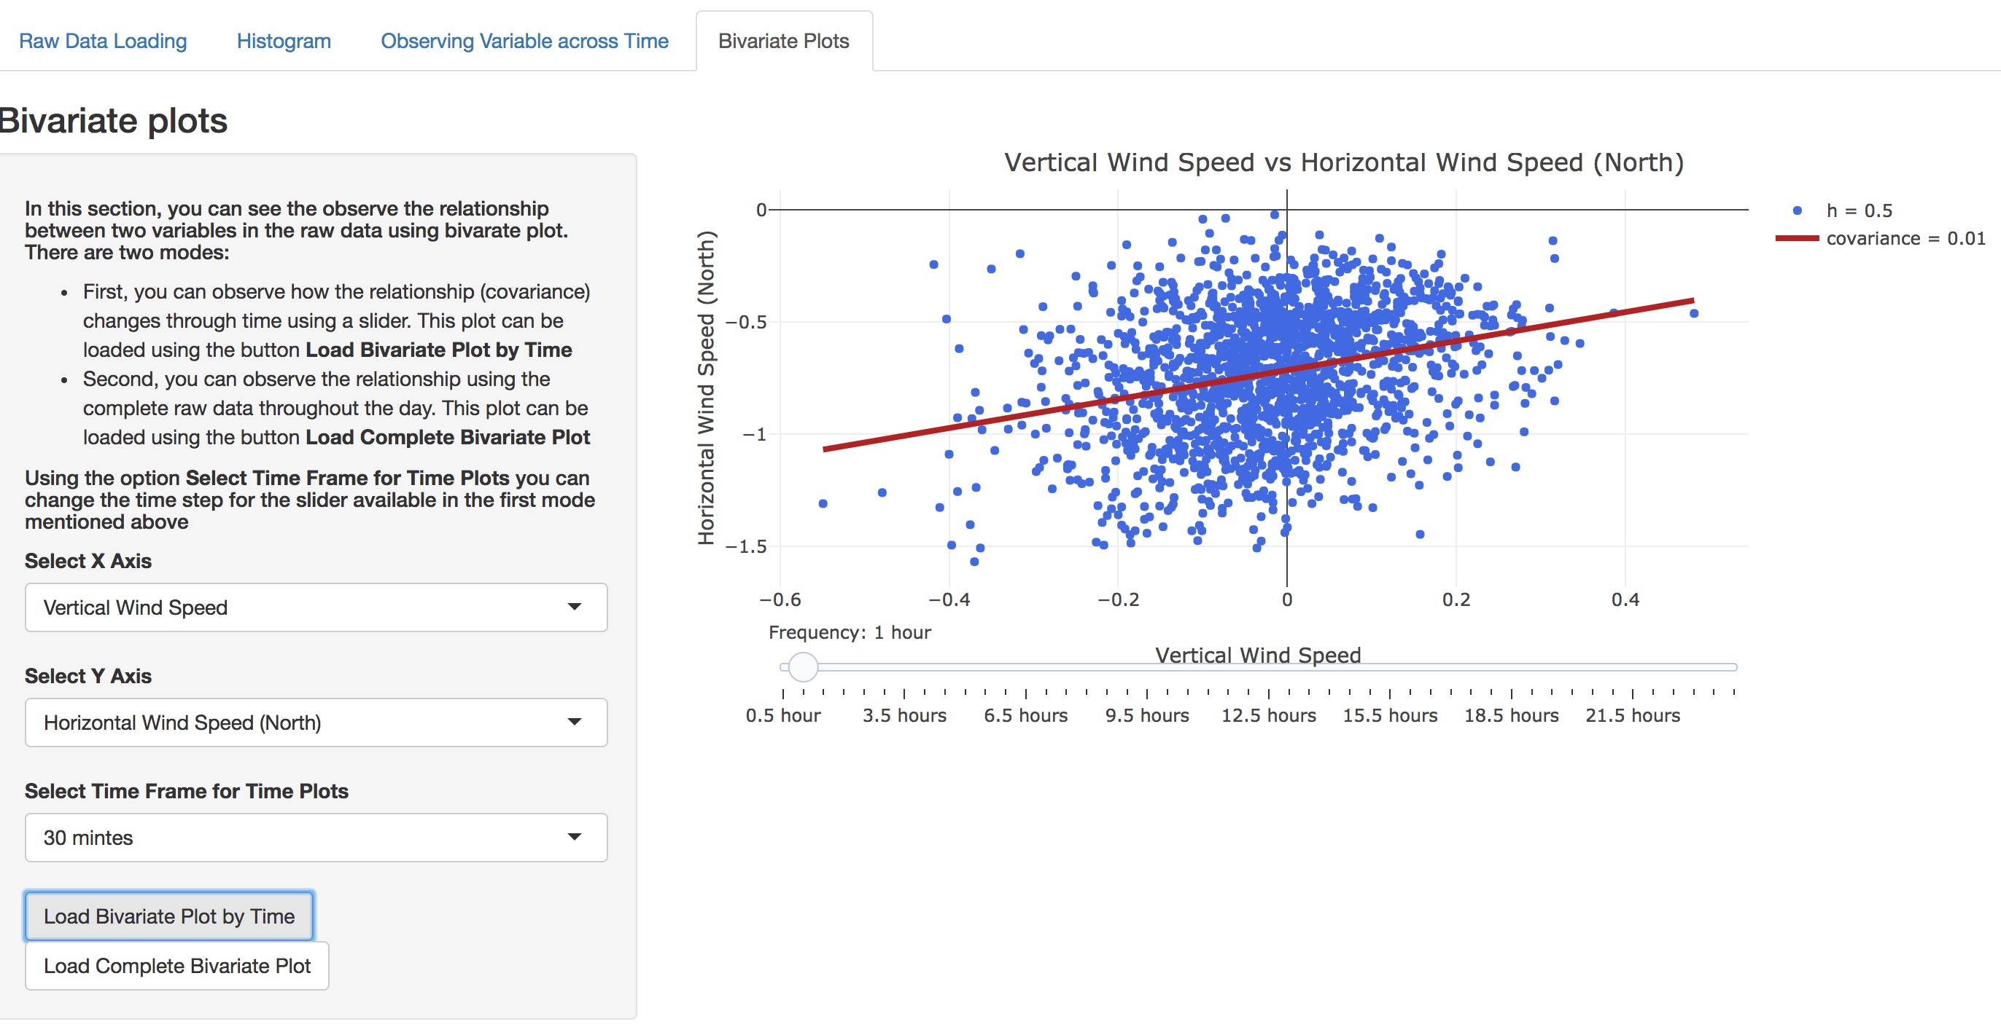
Bivariate plots
Students can observe how the relationship (covariance) changes through time using a slider.

Slide 9
Processed Data
In this portion the students are given the solution when the eddy covariance model is used on the raw data.
At the end of this portion the students will use their predictions from the raw data exploration to produce a regression builder to fill in gaps on the Data

Slide 10
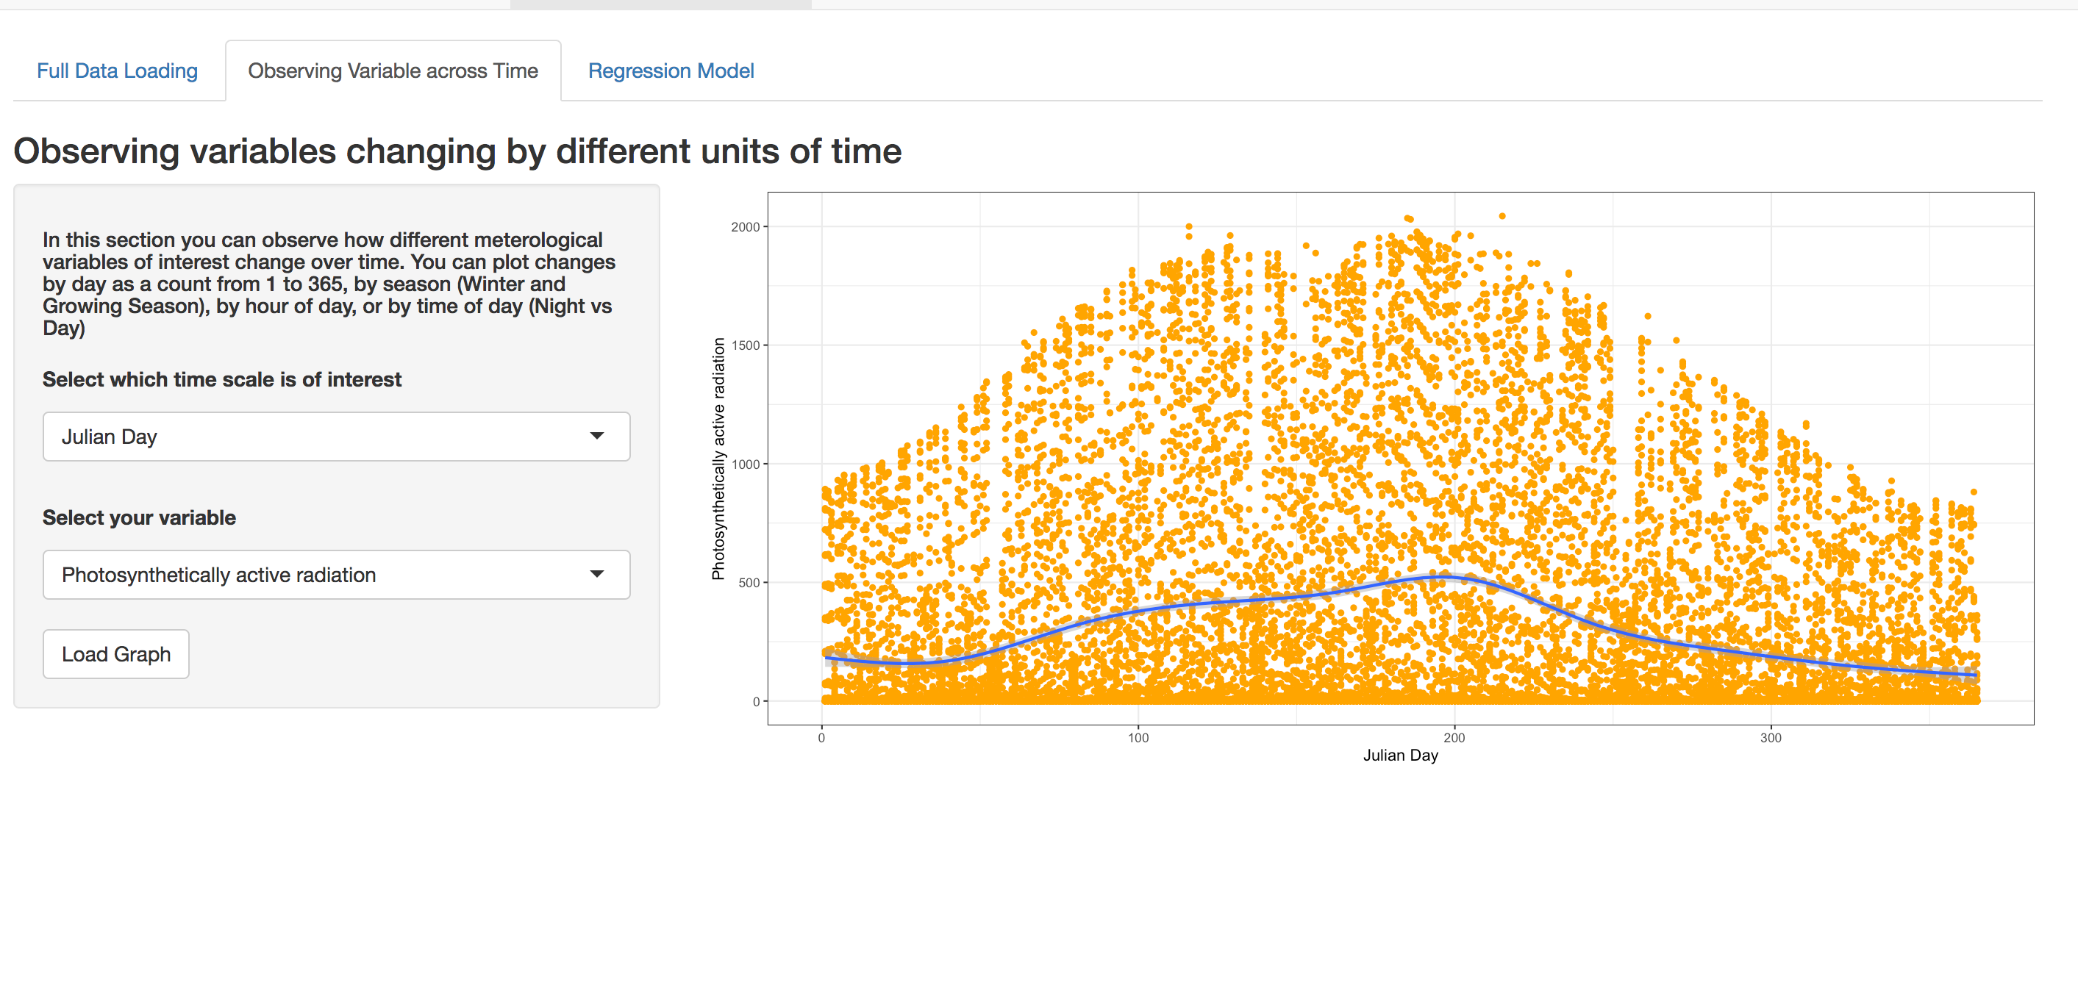
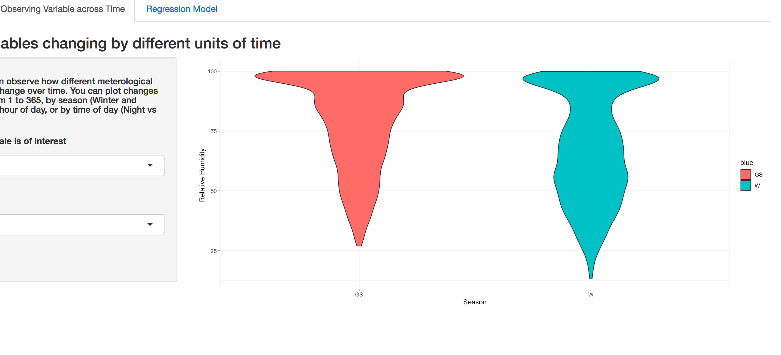
Variable Vs TIme
Here the students will be able to see how different meteorological variables of interest change over time.

Slide 11
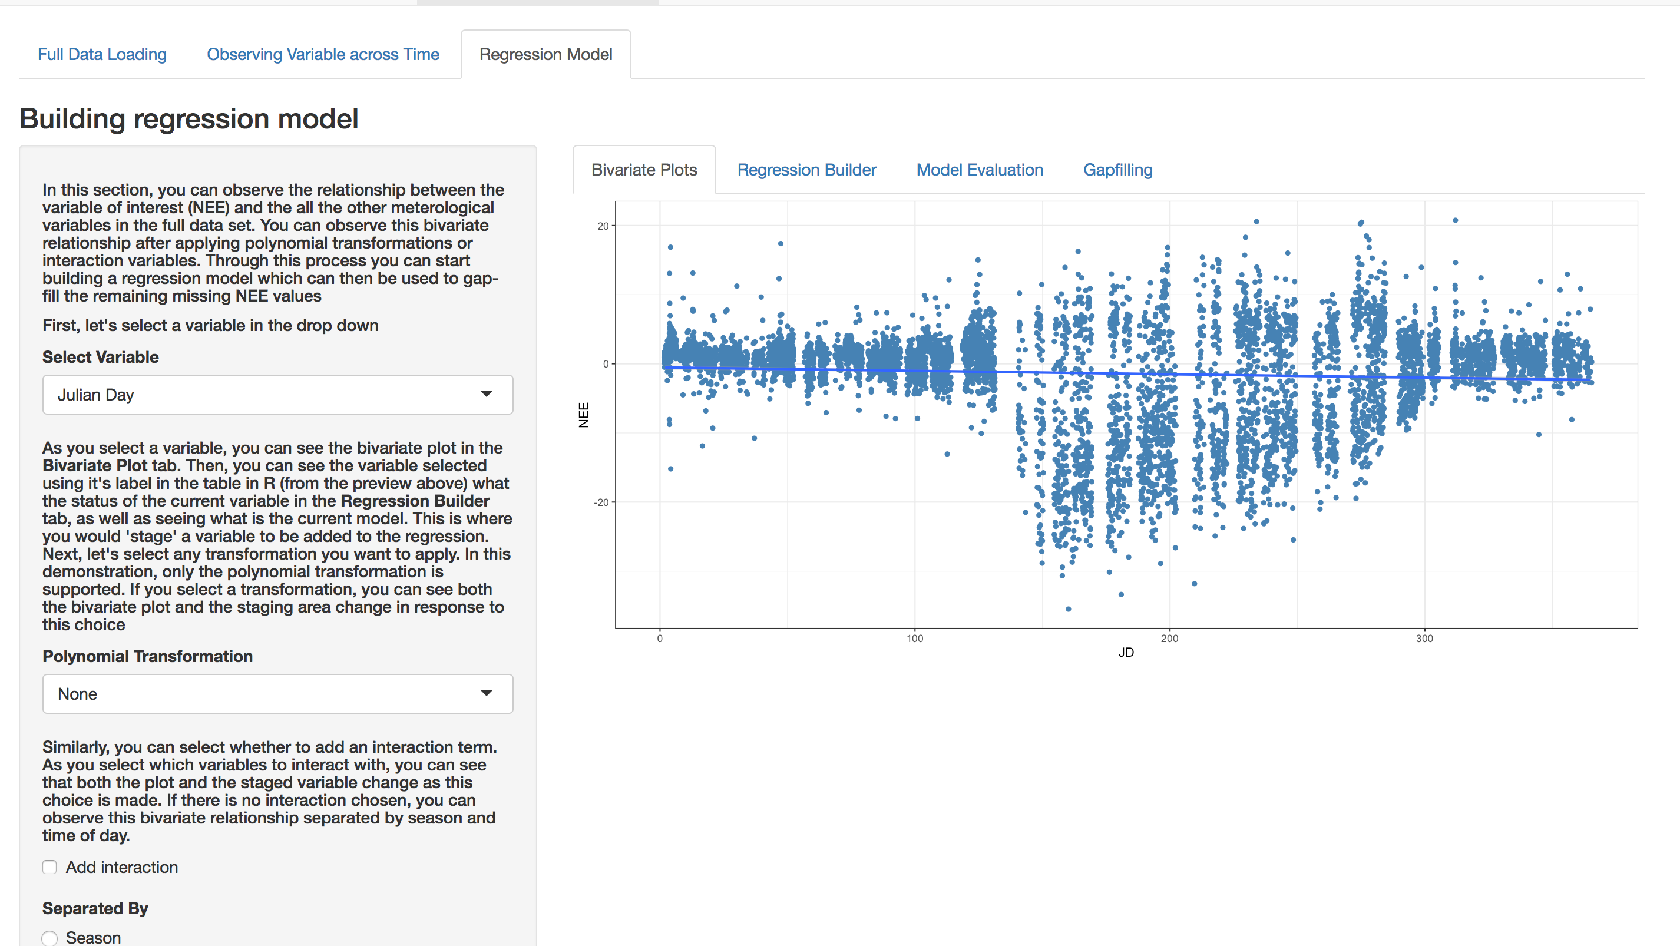
Regression builder
In the final module of the lab students will be able to produce different formulas for the regression model.
They can observe how their model will predict

